Slide 1
String Solving at Scale
Amit Goel
Principal Applied Scientist Automated Reasoning in Identity

Slide 2
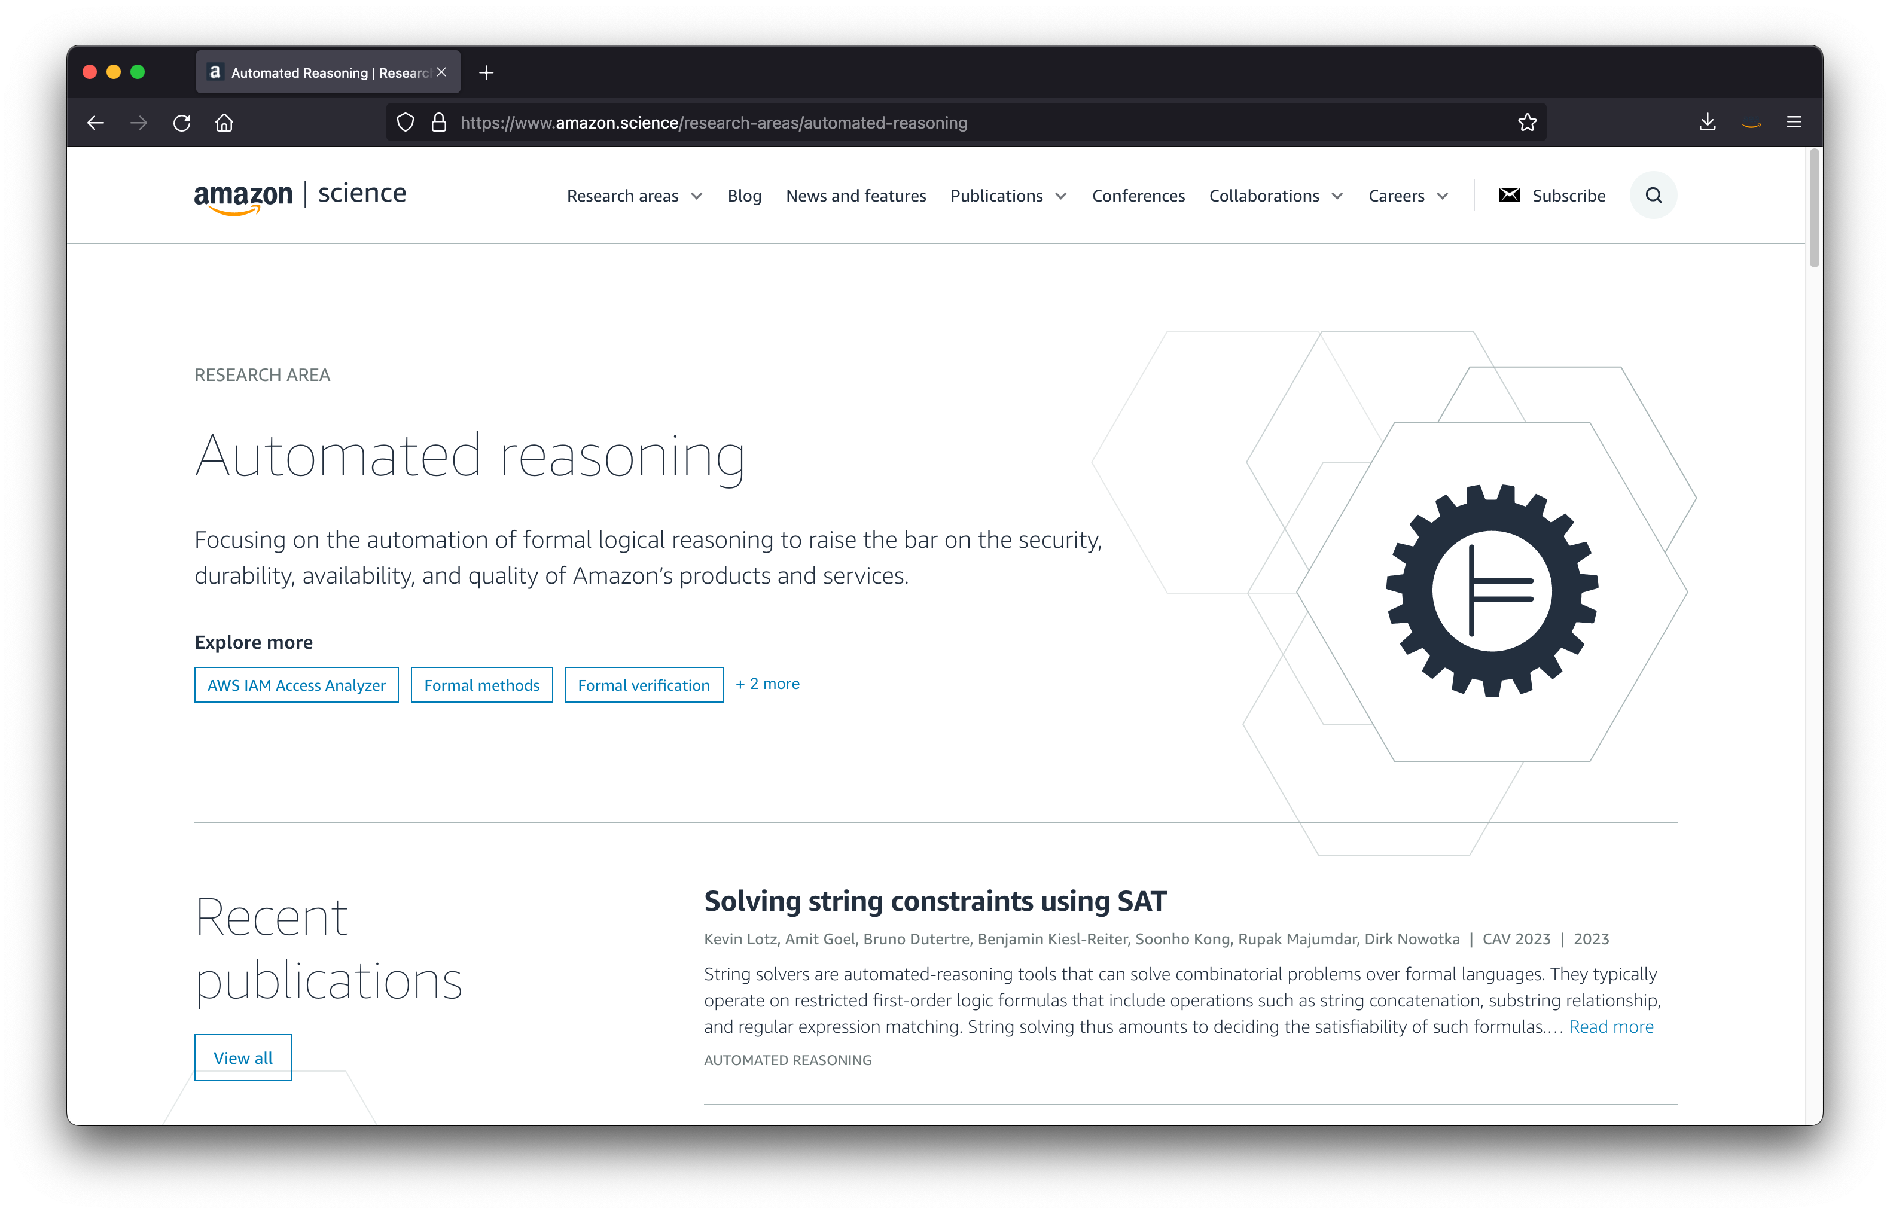

Slide 3
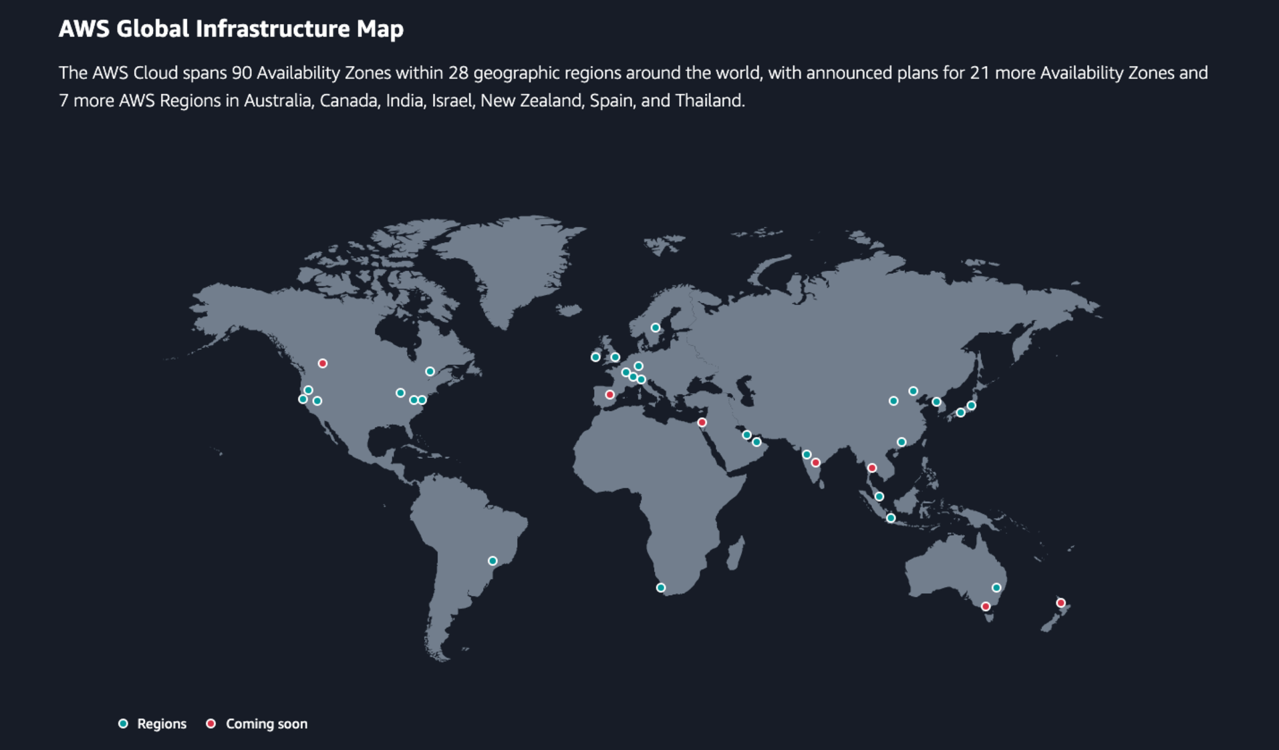

Slide 4
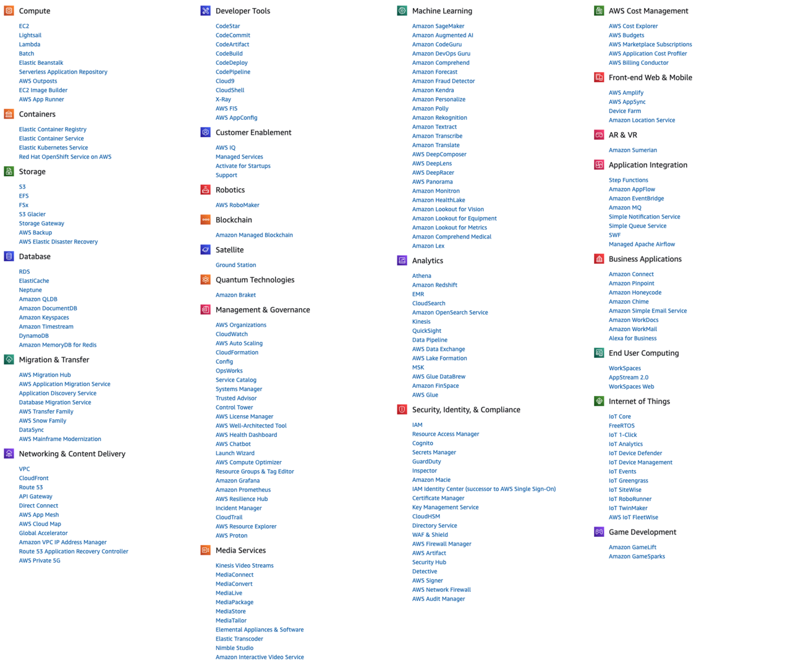

Slide 5
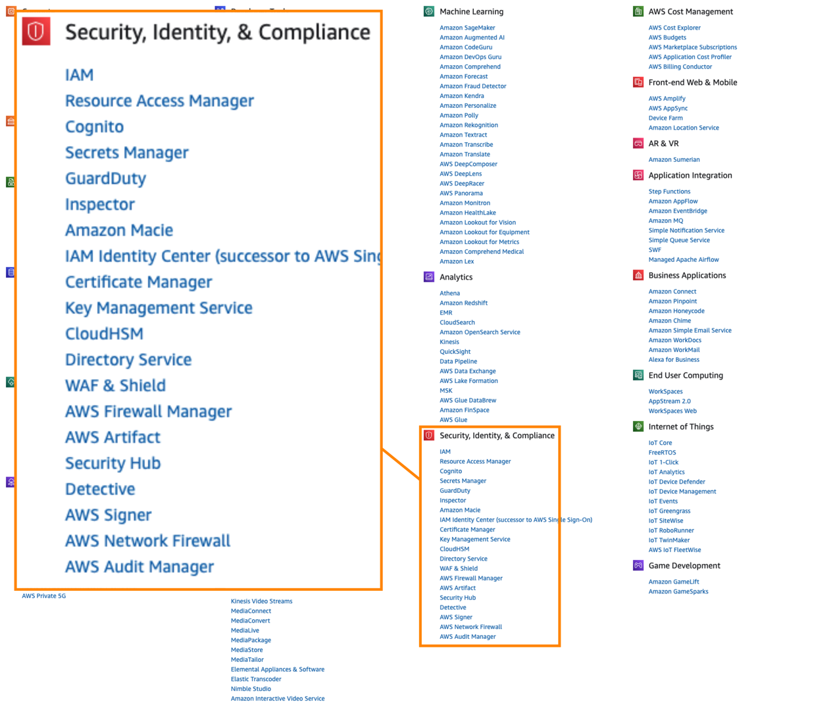
Identity & Access Management

Slide 6
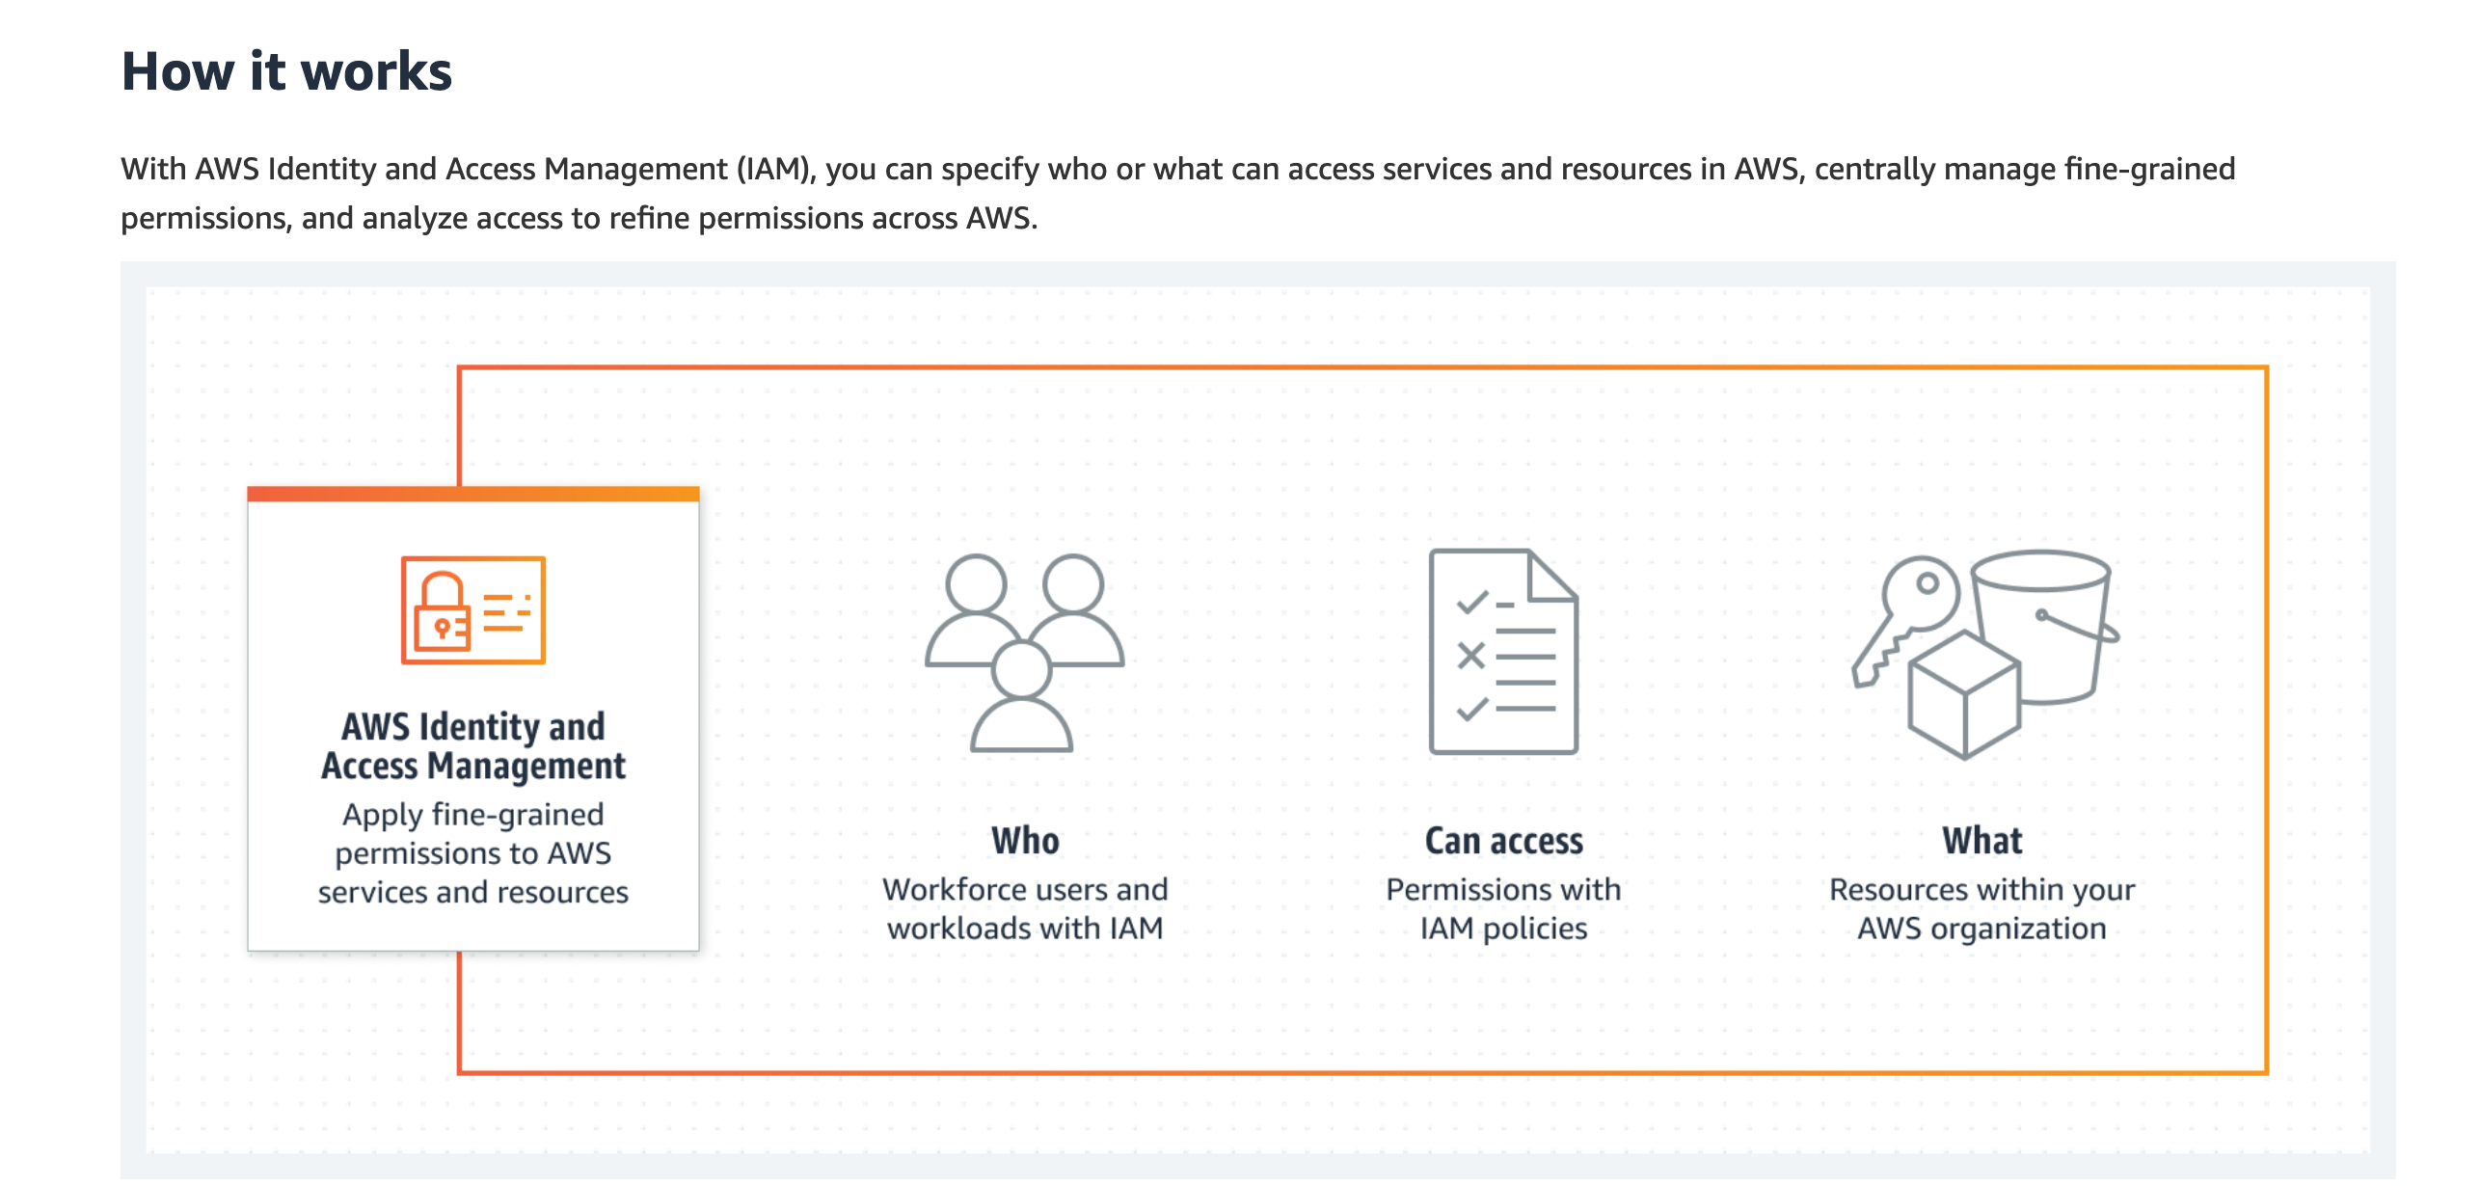
Identity and Access Management

Slide 7
IAM Policy Example
{
"Statement": [
{
"Effect": "Allow",
"Principal": {
"AWS": "111122223333"
},
"Action": "s3:GetObject",
"Resource": "arn:aws:s3:::my-bucket/*” },
{
"Effect": "Deny",
"Principal": "*",
"Action": "*",
"Resource": "arn:aws:s3:::my-bucket/*", "Condition": {
"StringNotLike": {"aws:RequestedRegion": "us-*"} } }
]
}
Who …
… is allowed to do what …
… to what resources?

Slide 8
IAM Policy Example: Strings
{
"Statement": [
{
"Effect": "Allow",
"Principal": {
"AWS": "111122223333"
},
"Action": "s3:GetObject",
"Resource": "arn:aws:s3:::my-bucket/*” },
{
"Effect": "Deny",
"Principal": "*",
"Action": "*",
"Resource": "arn:aws:s3:::my-bucket/*", "Condition": {
"StringNotLike": {"aws:RequestedRegion": "us-*"} } }
]
}

Slide 9
IAM Policy Example: Types and Operators
{
"Statement": [
{
"Effect": "Allow",
"Principal": {
"AWS": "111122223333"
},
"Action": "s3:GetObject",
"Resource": "arn:aws:s3:::my-bucket/*” },
{
"Effect": "Deny",
"Principal": "*",
"Action": "*",
"Resource": "arn:aws:s3:::my-bucket/*", "Condition": {
"StringNotLike": {"aws:RequestedRegion": "us-*"} } }
]
}
String operators
Numeric operators
Date operators
Boolean operators
IP address operators
ARN operators

Slide 10
Zelkova IAM Policy Analysis

Slide 11
Zelkova
Precisely models IAM policies Answers universal questions Using automated reasoning

Slide 12
IAM Policy Example: Semantics
{
"Statement": [
{
"Effect": "Allow",
"Principal": {
"AWS": "111122223333"
},
"Action": "s3:GetObject",
"Resource": "arn:aws:s3:::my-bucket/*” },
{
"Effect": "Deny",
"Principal": "*",
"Action": "*",
"Resource": "arn:aws:s3:::my-bucket/*", "Condition": {
"StringNotLike": {"aws:RequestedRegion": "us-*"} } }
]
}
$$P=\text{”}11112222333\text{”}∧$$
$A=$ “s3:GetObject” $∧$
$R$ $∈$ $ℒ($“arn:aws:s3:::my-bucket/*”$)$

Slide 13
IAM Policy Example: Semantics
{
"Statement": [
{
"Effect": "Allow",
"Principal": {
"AWS": "111122223333"
},
"Action": "s3:GetObject",
"Resource": "arn:aws:s3:::my-bucket/*” },
{
"Effect": "Deny",
"Principal": "*",
"Action": "*",
"Resource": "arn:aws:s3:::my-bucket/*", "Condition": {
"StringNotLike": {"aws:RequestedRegion": "us-*"} } }
]
}
$$P=\text{”}11112222333\text{”}∧$$
$A=$ “s3:GetObject” $∧$
$R$ $∈$ $ℒ($“arn:aws:s3:::my-bucket/*”$)$
$$P∈ ℒ(\text{“∗”})∧$$
$$A∈ ℒ(\text{“∗”})∧$$
$R$ $∈$ $ℒ($“arn:aws:s3:::my-bucket/*”$)$ $∧$
$∼({condExists}_{RR}∧RR∈ ℒ\left(\text{“}\text{us}\text{−∗”}\right))$

Slide 14
Allow and Deny
$$⟦P⟧≡\left(\bigvee_{S∈Allows\left(P\right)}{⟦S⟧}\right)∧\left(\bigwedge_{S∈Denies(P)}{¬⟦S⟧}\right)$$

Slide 15
Universal Questions
My S3 buckets are not publicly accessible
Nobody outside my organization can access my KMS keys
There is no cross-account access to my Lambda functions

Slide 16
Policy Comparisons
To check $P_{1}≤P_{2}$:
Translate $P_{1}$, $P_{2}$to logic
Check ${∃c. P}_{1}\left(c\right)∧¬P_{2}\left(c\right)$ ?
Policy 1
Zelkova
Policy 1 $≤$Policy 2 ?
Policy 2

Slide 18
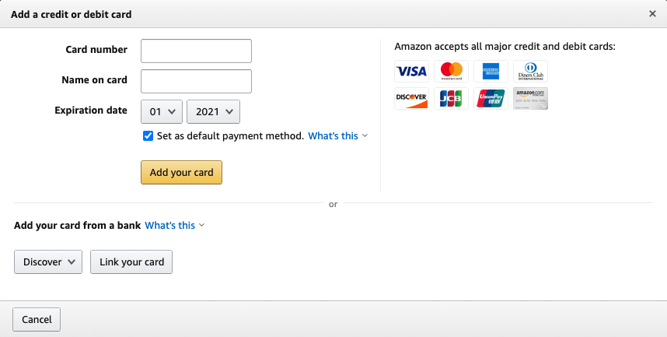
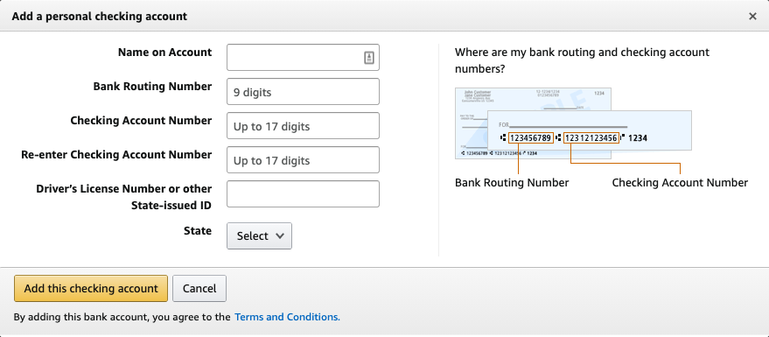
Amazon’s secure payment vault on AWS

Slide 19
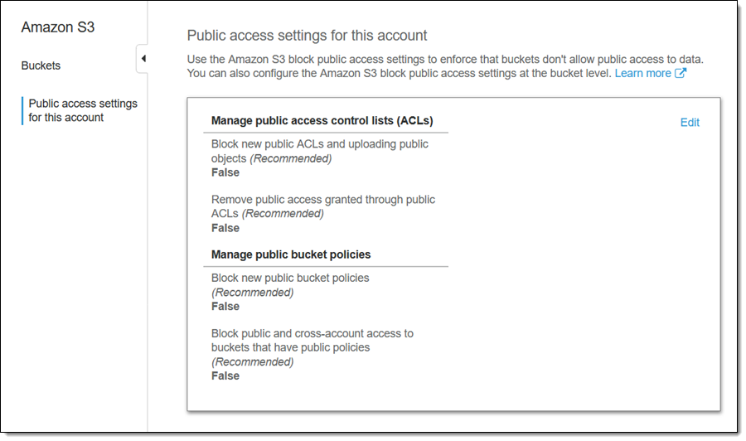
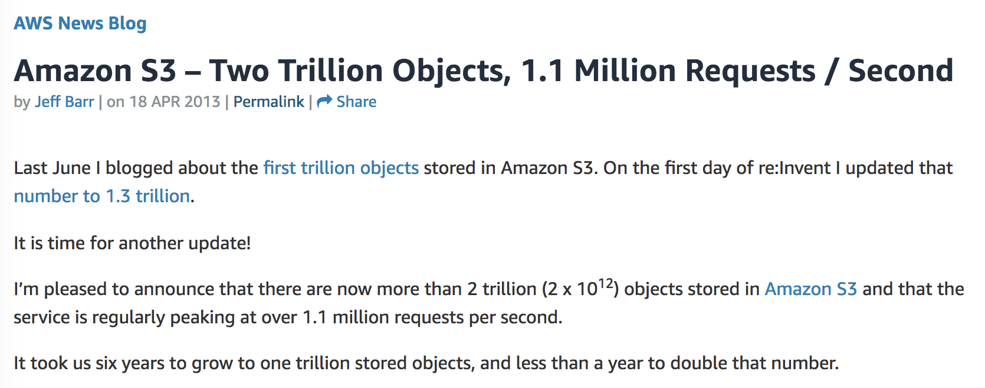
Preventative Controls @ S3 (Block Public Access)

Slide 20
Scaling Zelkova

Slide 21
Zelkova in the Cloud

Slide 22
Zelkova Improvements

Slide 23
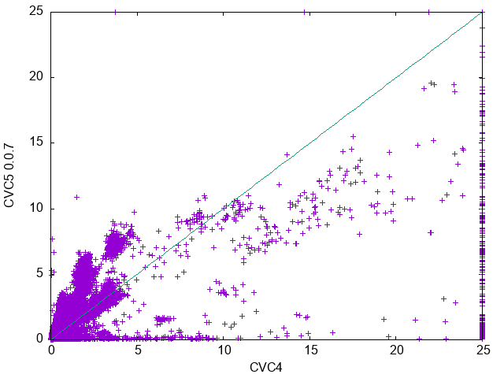
Solver Improvements

Slide 24
Zelkova Implementation
Policy 1
Zelkova
SMT Portfolio
Policy 1 $≤$Policy 2 ?
Policy 2

Slide 25
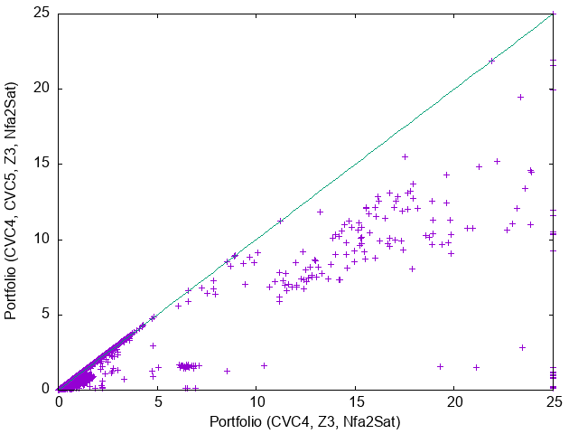
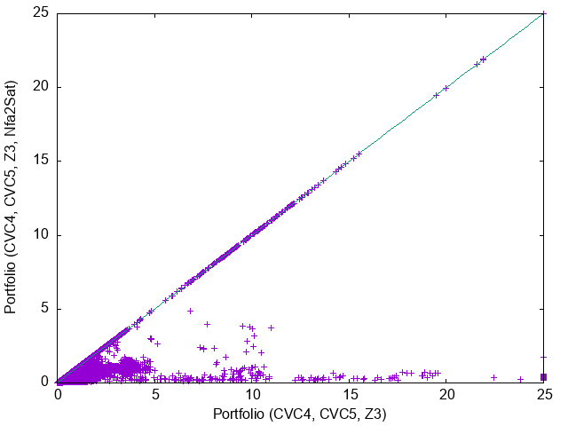
Better Together

Slide 26
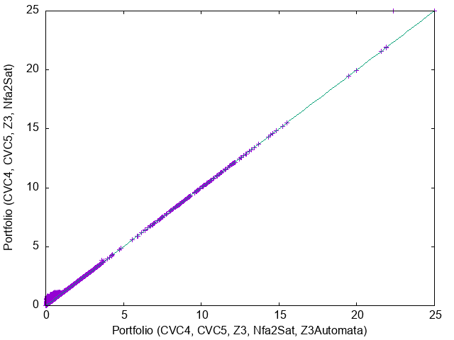
Are more solvers Always Better?

Slide 27
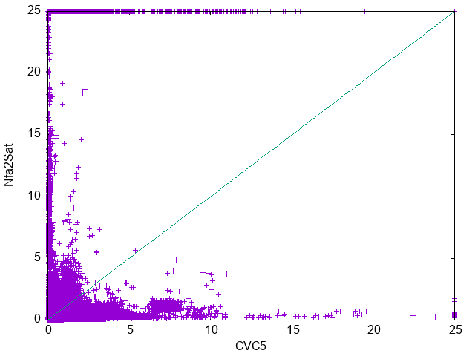
Solver Diversity

Slide 28
Encoding Differences
"Action": "s3:GetObject"
"Resource": "arn:aws:s3:::my-bucket/*”
"aws:SourceArn": "arn:aws:sns:us-east-2:444455556666:MyTopic"
"Action": "s3:Get*”
Regex $A∈ ℒ($“s3:Get*”)
Word equation $A=A_{ns}∙”:”∙A_{n} ∧$ $A_{ns}=\text{“}\text{s}\text{3”} ∧$ $A_{n}$ $∈ ℒ($“Get*”)

Slide 29
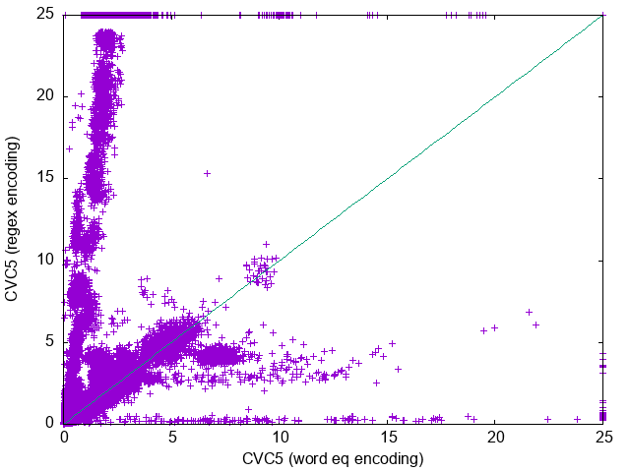
Encoding Differences

Slide 30
Encoding Choices: Revisiting Assumptions
Regular Expressions vs Containment constraints “a*b*c”$⟼$prefix(”a”, v) $∧$ contains(“b”, v) $∧$ suffix(“c”, v) “ab*ba” $⟼$prefix(”ab”, v) $∧$ suffix(“ba”, v) $∧$ v $≠$ ”aba”
Case Insensitive Operators (StringEqualsIgnoreCase, s3:prefix, Uploads)

Slide 31
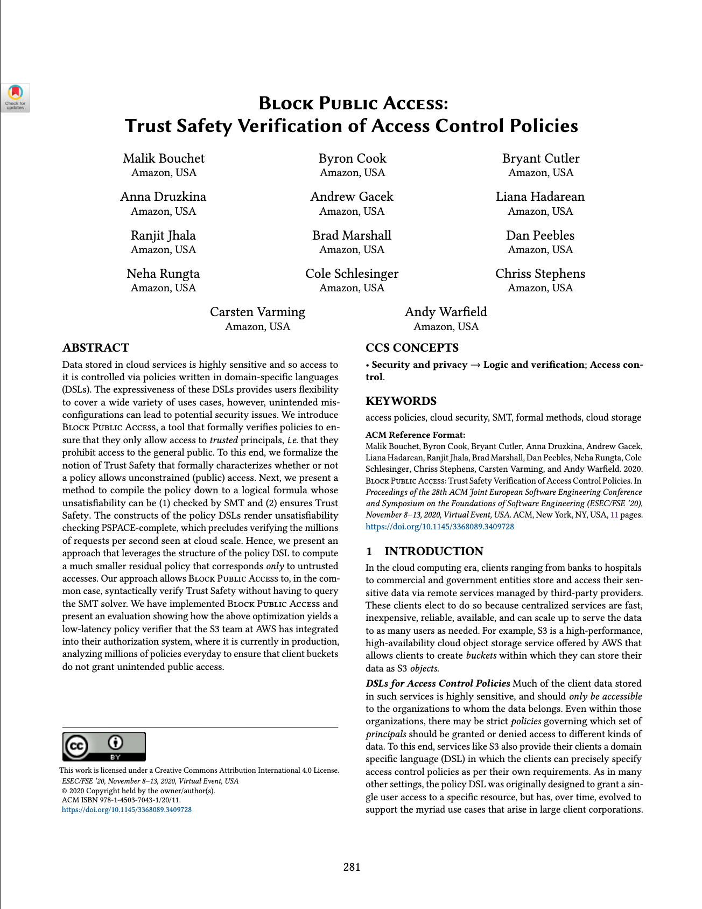
Avoiding SMT
Block Public Access check for untrusted accesses
Optimization: Elide trusted accesses
Improvement: Better detection of trivial cases

Slide 32
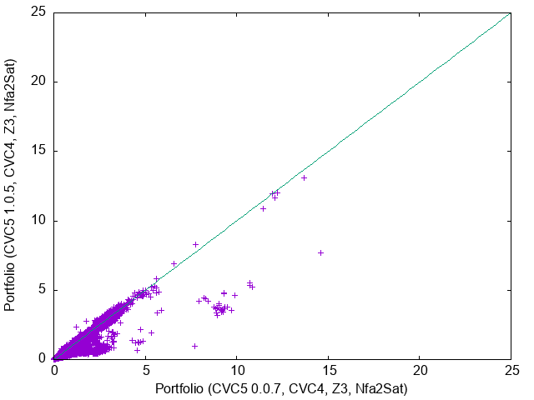
Parser Improvements

Slide 33
Directions for Solvers

Slide 34
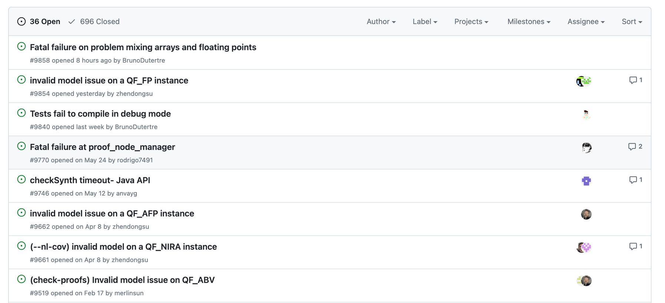
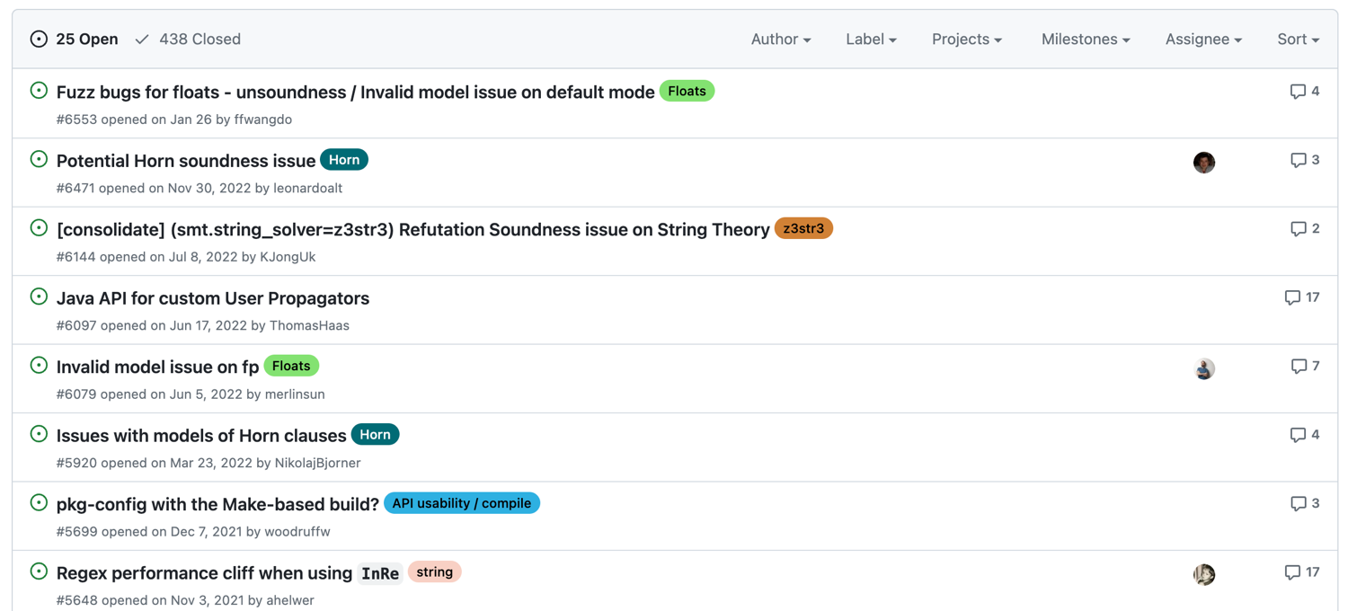
Correctness

Slide 35
Performance and Reliability
Portfolio performance
Solver diversity
Domain specific solvers
Tools to help tune performance
Configurations
Encoding choices
Monotonic Improvements

Slide 36
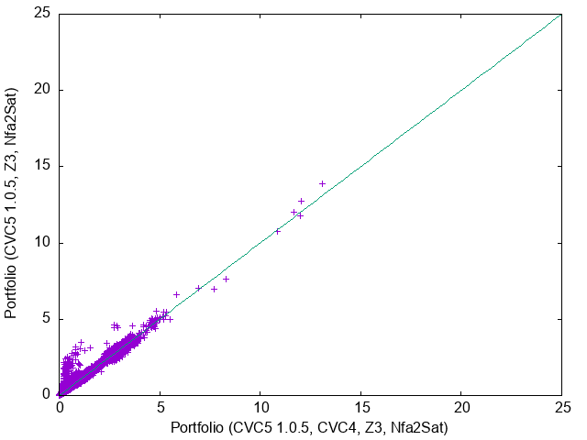
Monotonic Improvements

Slide 37
Features
Soft constraints
Better incremental solving
Efficient All-Sat

